Slide 1
Exploring PyQt5: A Comprehensive Guide to the Python Library
Created by Mubashir Baig

Slide 2
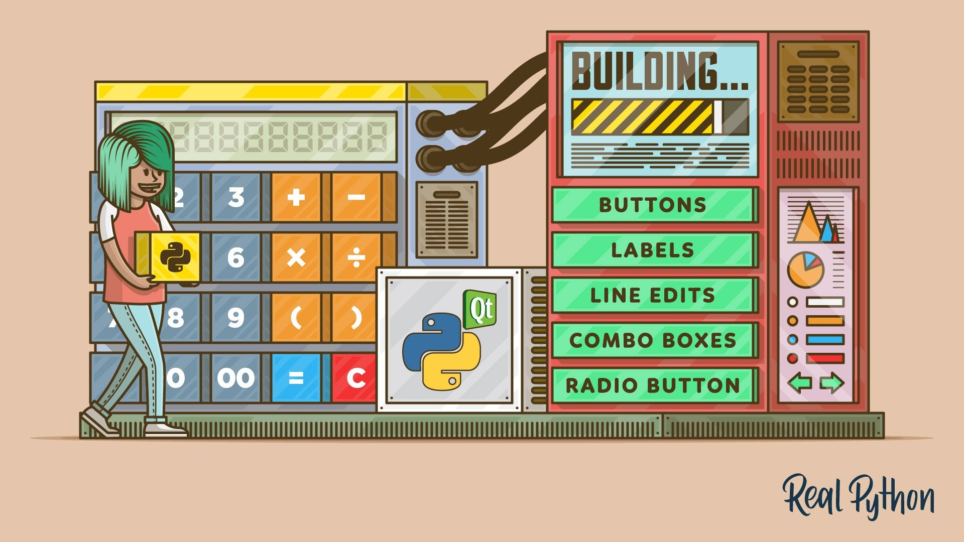
Introduction to PyQt5
Installing PyQt5 Library
Creating a PyQt5 Application
Using PyQt5 with Python
PyQt5 basics
PyQt5 Code Examples
Conclusion

Slide 3

Introduction to PyQt5
PyQt5 is a Python library for creating desktop applications with a graphical user interface (GUI). It is used to create GUI applications and other graphical user interfaces. PyQt5 is based on the Qt framework, which is a popular C++ GUI library used for creating applications for multiple platforms, including Windows, Linux, and macOS.
PyQt5 is a great choice for creating GUI applications as it is easy to use and provides a wide range of features. It is also cross-platform, so it can be used on any platform that supports Python and Qt.
It provides a set of classes that allow you to create windows, widgets, menus, dialogs, and more.

Slide 4
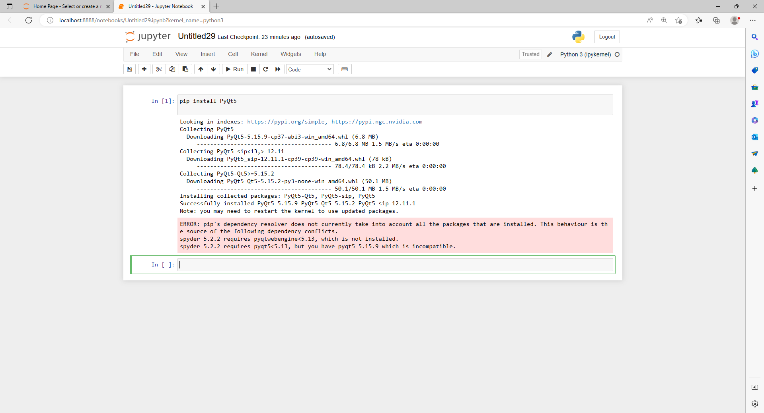
Installing PyQt5 module
First, we need to install PyQt5 library. For this, type the following command in the terminal or command prompt.
pip install PyQt5
It may take some time to install. Once you have installed PyQt5, you can start writing your own code. You will need to import the PyQt5 modules

Slide 5
Understanding basic concepts
There are a few key concepts to introduce about how applications are organized in the Qt world
QApplication:
In PyQt5, the QApplication object is a mandatory object that represents the entire application. It is responsible for managing the application's main event loop, processing events, and dispatching them to the appropriate widgets.
The QApplication object needs to be created before any other PyQt5 object is created
The QApplication object is typically created in the application's main() function
QMainWindow:
The QMainWindow class is a widget that represents the main window of an application. It provides a framework for creating a main window with a menu bar, a toolbar, a status bar, and other common user interface elements.
Qwidgets:
A widget is a graphical element that can be displayed on the screen, such as a button, a label, or a text box
Layout:
QHBoxLayout:Linear horizontal layout
QVBoxLayout:Linear vertical layout

Slide 6
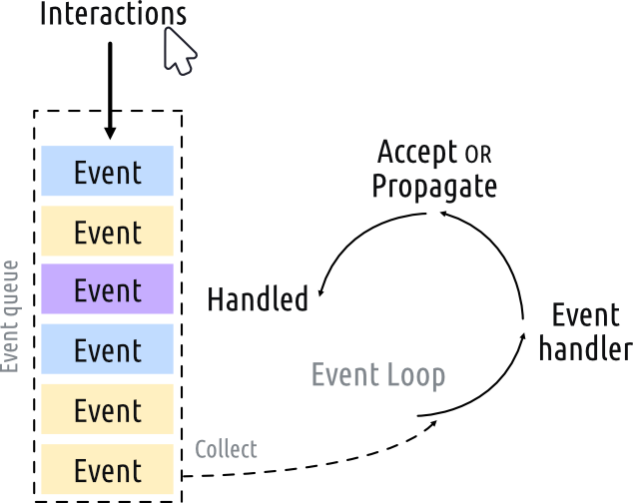
Event loop
Each interaction with your application whether a press of a key, click of a mouse, or mouse movement generates an event
The event loop is a mechanism that runs continuously and listens for events such as mouse clicks, keyboard input, and window resizing. When an event occurs, the event loop dispatches the event to the appropriate widget, which can then handle the event by performing some action or updating its state
In the event loop, the queue is checked on each iteration and if a waiting event is found, the event and control is passed to the specific event handler for the event
The event loop is started automatically when you create a QApplication object, and it continues running until the application is closed. While the event loop is running, you can interact with the widgets in your application by clicking on buttons, entering text into fields, and so on
Without it, our application would be unable to receive user input or respond to changes in the environment.

Slide 7
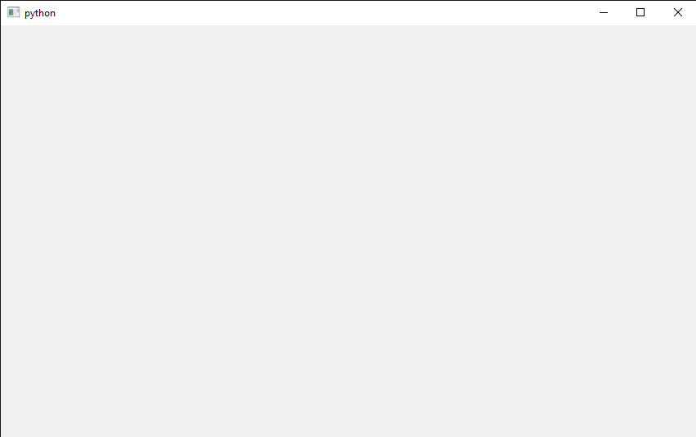
Creating a PyQt5 Application
Creating a QApplication Object
The QApplication class is the starting point of any PyQt5 application. It initializes the Qt framework and provides the event loop that handles user input and updates the UI
The main module for PyQt5 are QtWidgets,QtCore,QtGui , We will be using these modules based on our need.
Code to initialize application:
from PyQt5.QtWidgets import QApplication
app = QApplication([])
but this wont do much because we are not showing our window or executing it
Now we want to show our application on our screen so, we will create main window
from PyQt5.QtWidgets import QApplication, QMainWindow
app = QApplication([])
window = QMainWindow()
window.show()
# Start the event loop.
app.exec()
This code will execute a simple application

Slide 8
Create application in class
We have simply executed the program simply but working in application we have to work in class
Why work in class?
We work with classes when creating PyQt5 applications to organize our code in a structured and reusable way . Each class represents a different user interface element, and we can add custom behavior and functionality to our widgets by subclassing existing widgets Overall, working with classes in PyQt5 helps us create flexible, modular, and maintainable applications that can be customized and extended as needed.
So now we create simple application in class
from PyQt5.QtWidgets import QApplication, QMainWindow
# Subclass QMainWindow to customize your application's main window
class MainWindow(QMainWindow):
def __init__(self):
super().__init__()
app = QApplication([])
window = MainWindow()
window.show()
app.exec()

Slide 9
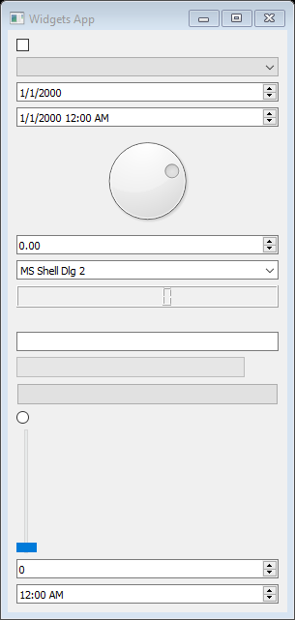
QWidgets
There are many widgets in PyQt5 but most commonly used are
1)QLabel 2)QPushButton 3)QLineEdit 4)QComboBox 5)QSlider 6 ) QFileDialog 7)QMessageBox
Qlabel (A widget that displays text or an image):
QPushButton(A button widget that emits a signal when clicked)
QComboBox ( A widget that allows the user to select from a list of options)
QLineEdit(A widget to take input from user)
Qslider(It provide slider in application)
QFileDialog(The QFileDialog class provides a dialog that allow users to select files or directories.)
QMessageBox(The QMessageBox class provides a modal dialog for informing the user or for asking the user a question
and receiving an answer)
This all can be imported simply by
from PyQt5.QtWidgets import QLabel, QPushButton, QLineEdit, QComboBox, QSlider, QFileDialog, QMessageBox

Slide 10
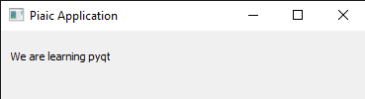
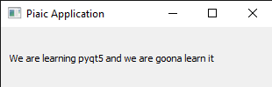
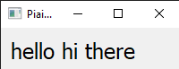
Adding widgets to the main window
Adding text to our window(Qlabel):
Text can be added through label in our window so main syntax will be same just we will import label and put it on our window
from PyQt5.QtWidgets import QApplication, QMainWindow,QLabel
# Subclass QMainWindow to customize your application's main window
class MainWindow(QMainWindow):
def __init__(self):
super().__init__()
self.setWindowTitle("Piaic Application")
label = QLabel("We are learning pyqt5",self)
app = QApplication([])
window = MainWindow()
window.show()
app.exec()
As you can it show the text but some text is missing
You can solve it by giving the label it geometry and size here is code for this
label.setGeometry(10,10,400,50)
The first argument is for position of x coordinate ,second is for y coordinate third is for width and fourth is for height
Same goes for all of the widgets and window can also be resize by it
You can also change the text of label with tis code
label.setText(“any string“ or variable)
For adding font and size of text you can use following command
from PyQt5.QtGui import QFont
label.setFont(QFont("Helavetica",18))

Slide 11
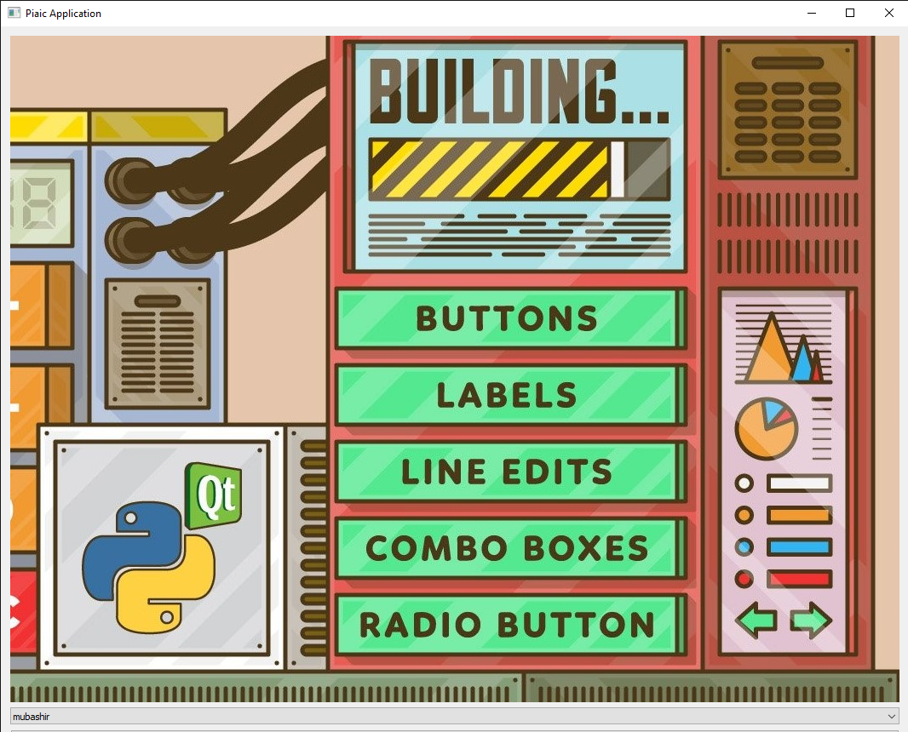
Add image to application
Adding picture is simple , first import the Qpixmap from QGui
from PyQt5.QtGui import QPixmap
Then inilize a variable without text and add image to it
self.label = QLabel(self)
self.label.setPixmap(QPixmap('C:/Users/rex/Pictures/a (2).jpg’))
In second line we are setting pixmap to our image in our app
As you can see it has been add to our background of application

Slide 12
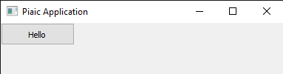
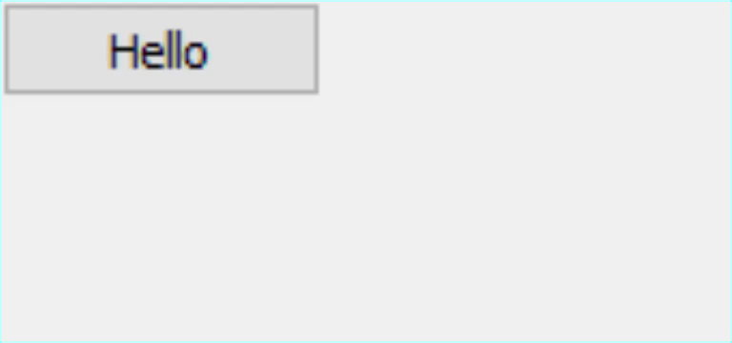
QPushButton
Button can be added same as label main application syntax will be same just we will add button in application
Code as follows:
First import the QPushButton
from PyQt5.QtWidgets import QApplication, QMainWindow,QLabel,QPushButton
Then
button = QPushButton("Hello", self)
Add this in application class you will have the button in your application,You can adjust the size and position of the button same as we did in label
When you click this button nothing happen because I havenot created any functionality regarding clicking this button
This functionality works on signals and slots
Signals are notifications emitted by widgets when something happens,signals can also send data to provide additional context about what happened
Slots is the name Qt uses for the receivers of signals,In your application can be used as a slot simply by connecting the signal to it. If the signal sends data, then the receiving function will receive that data too
We will use the slots to connect our button to do something we will create a function that will show button click text when clicked
button = QPushButton("Hello", self)
self.label = QLabel(self)
self.label.setGeometry(20,30,150,50)
button.clicked.connect(self.show_on_click)
def show_on_click(self):
self.label.setText("button has been clicked")
First we have created the push button in which we have give text and parent or widget then we have
Intialize a text label and set its size and position and button.clicked.connect is catching
The signal and calling our show_on_click which set the text to button has been clicked

Slide 13
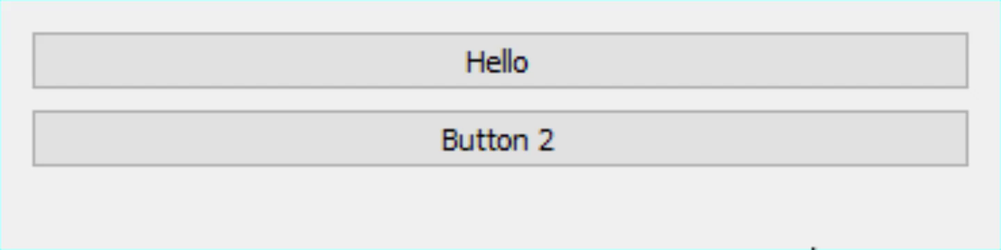
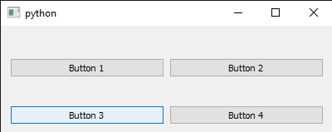
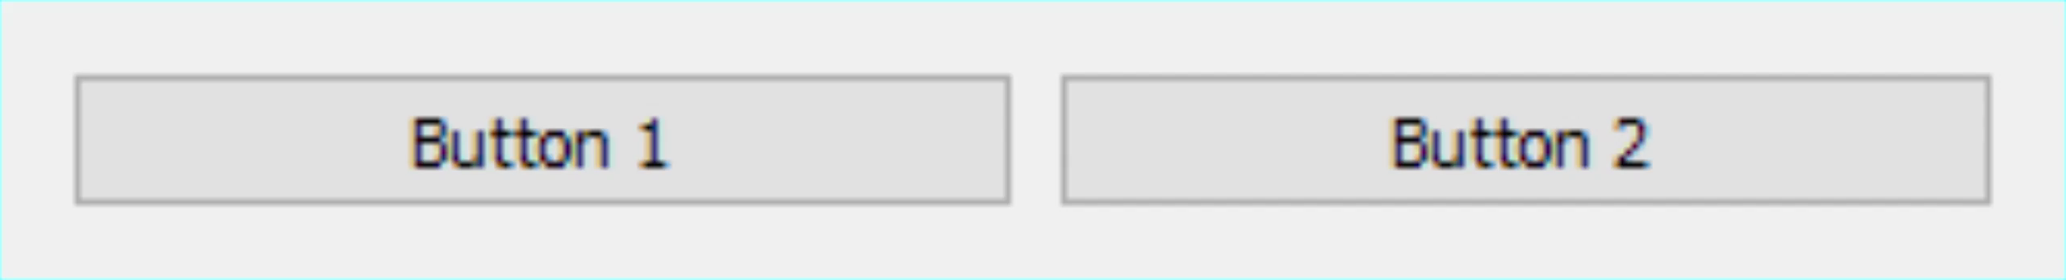
layout
Layouts: used to organize the widgets within a window, such as QHBoxLayout and QVBoxLayout etc.They make it easier to create a consistent and professional-looking user interface.
Why we need layout? In previous slide we have to give the position of the widgets in orders to see and place the properly ,Layout does that work for us example
There are several types of layouts available in PyQt5:
QVBoxLayout - A vertical layout arranges widgets vertically from top to bottom.
it is also imported same as widgets
from PyQt5.QtWidgets import QVBoxLayout
After importing it al the syntax is same just change the QMainWindow to QWidget
self.setWindowTitle("Piaic Application")
self.setLayout(QVBoxLayout())
button = QPushButton("Hello")
self.label = QLabel()
self.layout().addWidget(button)
self.layout().addWidget(self.label)
First we set layout to vertical layout and add our widgets to layout and horizontal layout will also work same it just arranges widgets horizontally left to right
Horizontal Layout example: Grid layout:
(require row and column)

Slide 14
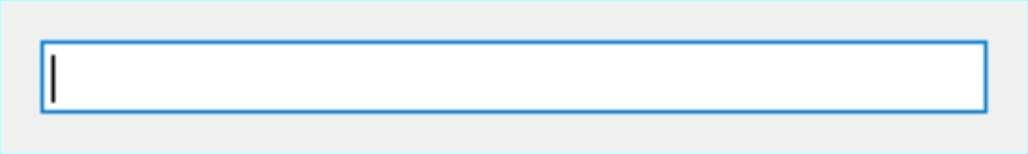
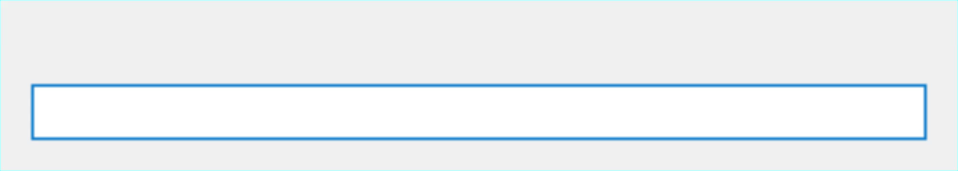
QLineEdit(Input box)
All the widgets are added to application same as button or label just their arguments are little bit different same goes for QLineEdit .
First Import it
from PyQt5.QtWidgets import,QLineEdit
Then call it input = QLineEdit() bracket will empty if using layout else parent should be given like(self)
This should give something like this
But this does do anything because now we have to get the text which is written in input and show it in application which can be get by following command
self.label = QLabel()
self.input = QLineEdit()
self.layout().addWidget(self.label)
self.layout().addWidget(self.input)
self.input.textChanged.connect(self.label.setText)
We have a label and lineEdit then we have add them in layout and we will catch signal every time text is written in lineEdit box and place it in label
You can also store this in a variable and do many this based on user inputs and also show when button is clicked command is as follows
self.lineEdit.text()
This will get the text when button function is called on button clicked

Slide 15
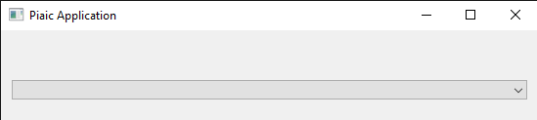
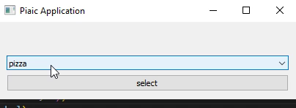
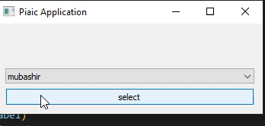
QComboBox
A widget that allows the user to select from a list of options
It can be simply imported as from PyQt5.QtWidgets import QComboBox and can be show on screen as
self.combobox = QComboBox() and add to layout self.layout().addWidget(self.combobox)
But there is nothing there so we have to add the content it can be string ,numbers,list etc
You can add data by following code
self.combobox.addItem("pizza")
self.combobox.addItem("burger")
And show the selected choice onscreen when clicking the button
self.label.setText(f"you have selected {self.combobox.currentText()}")
self.combobox.currentText() gets the currently selected choice from combo box
Multi items from list can also be added to combo box from command as
list1=["mubashir","arham","ali","waris"]
self.combobox.addItems(list1)

Slide 16
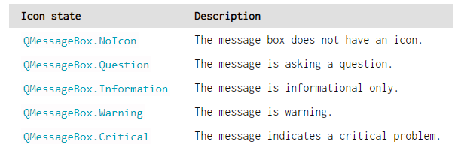
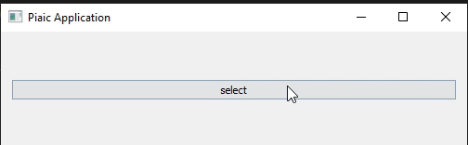
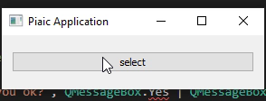
QMessageBox
Qt also provides a built-in message dialog class called QMessageBox. This can be used to create information, warning, about or question dialogs.
The example below creates a simple QMessageBox and shows it.it will show a message box when button is clicked
CODE:
def show_on_click(self):
dlg = QMessageBox(self)
dlg.setWindowTitle("I have a question!")
dlg.setText("This is a simple dialog")
dlg.exec()
This create a simple message but if you want to give options to user so we change the following you can also change icon of message
Following code can be use for multiple button
def handle_button_click(self):
reply = QMessageBox.warning(self, 'Message', 'Are you ok?', QMessageBox.Yes | QMessageBox.No)
if reply == QMessageBox.Yes:
print("Yes!")
else:
print("No!")
In this code we have we have initialize QMessageBox.warning so it will show with warning sign this can be change with above icon state command
Then we have give title of message box and third give text of message box then set the button in our message box and create simple if else condition if yes is selected it will print yes else no
The above can also be done by this
dlg.setStandardButtons(QMessageBox.Yes | QMessageBox.No)
dlg.setIcon(QMessageBox.Question)
button = dlg.exec()

Slide 17
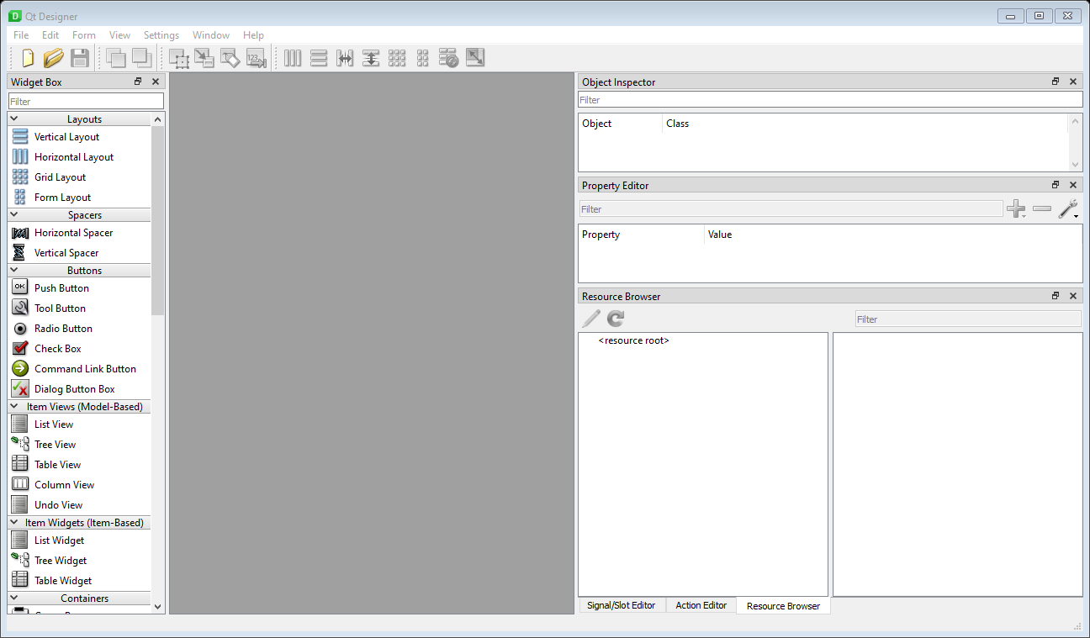
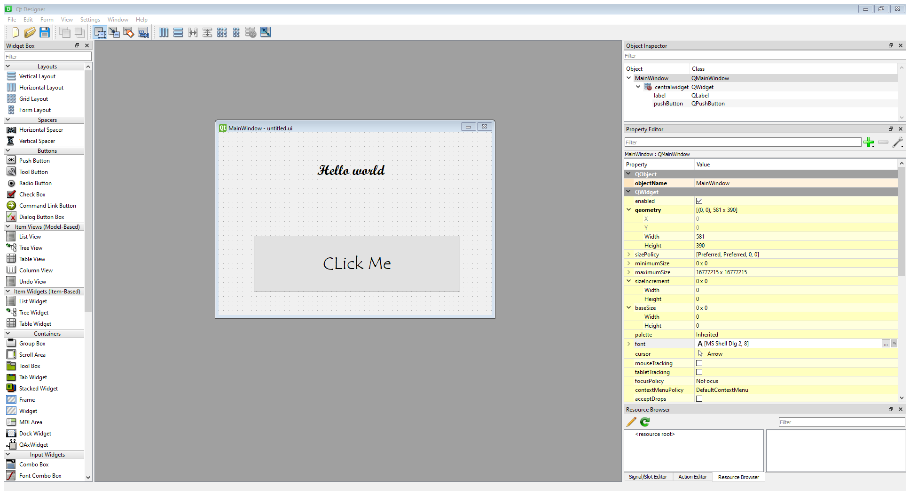
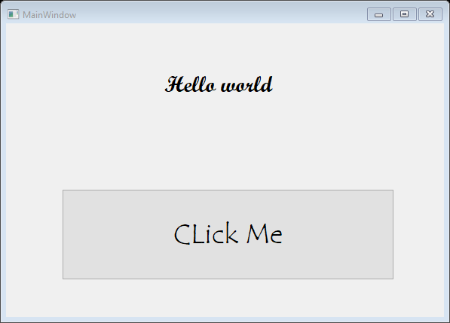
Qt Designer
So far we have been creating apps using Python code. This works great in many cases, but as your applications get larger or interfaces more complicated, it can get a bit difficult to define all widgets programmatically. The good news is that Qt comes with a graphical editor Qt Designer which contains a drag-and-drop UI editor. Using Qt Designer you can define your UIs visually and then simply hook up the application logic later.
Install the PyQT5 Designer
pip install PyQt5Designer
Open it by writing below command in terminal
designer.exe
You can now create Ui in designer. After creating ui in designer save the file
Like this
Then you can convert Ui file in python by following command
pyuic5 -x {ui file name}.ui –o {file name which you want to convert it }.py
This will convert it in python and you can run

Slide 18
Conclusion
Now after this you have learn the tiny bit basics of PyQt5 ,PyQt5 is enormous library and lot of time is needed to learn most of it but basic functions can be created through same method
If you want to learn more here are the resources
First the playlist of PyQt5 basics tutorial https://www.youtube.com/playlist?list=PLCC34OHNcOtpmCA8s_dpPMvQLyHbvxocY
It have amazing guide to many functions and basics projects
Second this website which has also detailed guide and tutorials on PyQt5
https://www.pythonguis.com/pyqt5/
Hope you get some knowledge from this presentations
Created by Mubashir Baig

